Slide 1


TECHNOLOGY REVIEW
CSE 583 Project
SPOTIFY MUSIC RECOMMENDATION SYSTEM
Juntong Wu, Denkie Yan, Chesie Yu
PLAY

Slide 2






Project Overview
Spotify Music Recommendation System · CSE583 · 2023 · np.inf Plays
Summary:
Discover patterns and trends from the Spotify dataset (i.e., music evolution, popular genre, etc.)
Develop a music recommendation system using content/collaborative filtering
Design an interactive user interface to engage with visualization dashboards and music suggestions
Objective:
Deliver a personalized & insightful music discovery experience for users

Slide 3
Deliverable & Use Case
Spotify Music Recommendation System · CSE583 · 2023 · np.inf Plays
Deliverable:
Interactive user interface that presents historical music insights + provides personalized music recommendations
Use Case:
Scenario: Dave is seeking personalized music recommendations tailored to his taste
Input: Dave enters his name at the home page
Process: The system accesses Dave’s listening history/preferences and generates recommendations accordingly
Output: Provides personalized music profile featuring a custom playlist that reflects Dave’s music tastes

Slide 4
Requirements
Spotify Music Recommendation System · CSE583 · 2023 · np.inf Plays
Functional Requirements (For Users):
Interactivity: Interactive interface enhancing user engagement
Customization: Customizable controls catering to user preferences
Usability: User-friendly interface simplifying user experience
Other Criteria (For Us):
Integration: Compatibility with other tools and packages
Implementation: Ideally, not too difficult to implement :)

Slide 5








Packages
TKinter
Shiny
Plotly Dash
Streamlit
Standard GUI library
Reactive programming engine
Creating interactive web applications
Python for analytics
Prototype of dashboard

Slide 6






TKinter
Your Library
Packages
#
Features
Recents
Easy to understand and master
TKinter
1
Package · Python
2
Fast to implement as compared to any other GUI toolkit
Shiny
3
Limited Widgets
Package · Python
4
Older design and it looks outdated
Plotly Dash
Package · Python
Streamlit
Package · Python

Slide 7
Shiny
Your Library
Packages
#
Features
Recents
TKinter
1
Work integrate with popular visualization packages
Package · Python
2
Create highly interactive dashboards with reactive components
Shiny
3
Required knowledge of Bootstrap to change UI
Package · Python
4
Limited Customization
Plotly Dash
Package · Python
Streamlit
Package · Python

Slide 8
Plotly Dash
Your Library
Packages
#
Features
Recents
TKinter
1
Allow users to explore data in a dynamic manner
Package · Python
2
Compatible with other plotting libraries and languages
Shiny
3
Doesn’t include all the features in the open source version
Package · Python
4
Require some extended CSS and HTML knowledge for customization
Plotly Dash
Package · Python
Streamlit
Package · Python

Slide 9
Streamlit
Your Library
Packages
#
Features
Recents
Easy to use
TKinter
1
Package · Python
2
Allow users to input data and view the results in real-time
Shiny
3
Predefined widgets for presenting various data types
Package · Python
4
Limited customization
Plotly Dash
Package · Python
Streamlit
Package · Python

Slide 10

Packages
TKinter
Shiny
Plotly Dash
Streamlit
Standard GUI library
Reactive programming engine
Creating interactive web applications
Python for analytics
Prototype of dashboard

Slide 11
Why Streamlit?
Streamlit Is The Best!! · CSE583 · 2023 · np.inf Plays
Allow users to explore data in a dynamic manner
Easy to use, no CSS and HTML knowledge requires
Comes with a range of pre-built components
Specifically designed for machine learning and data science

Slide 12
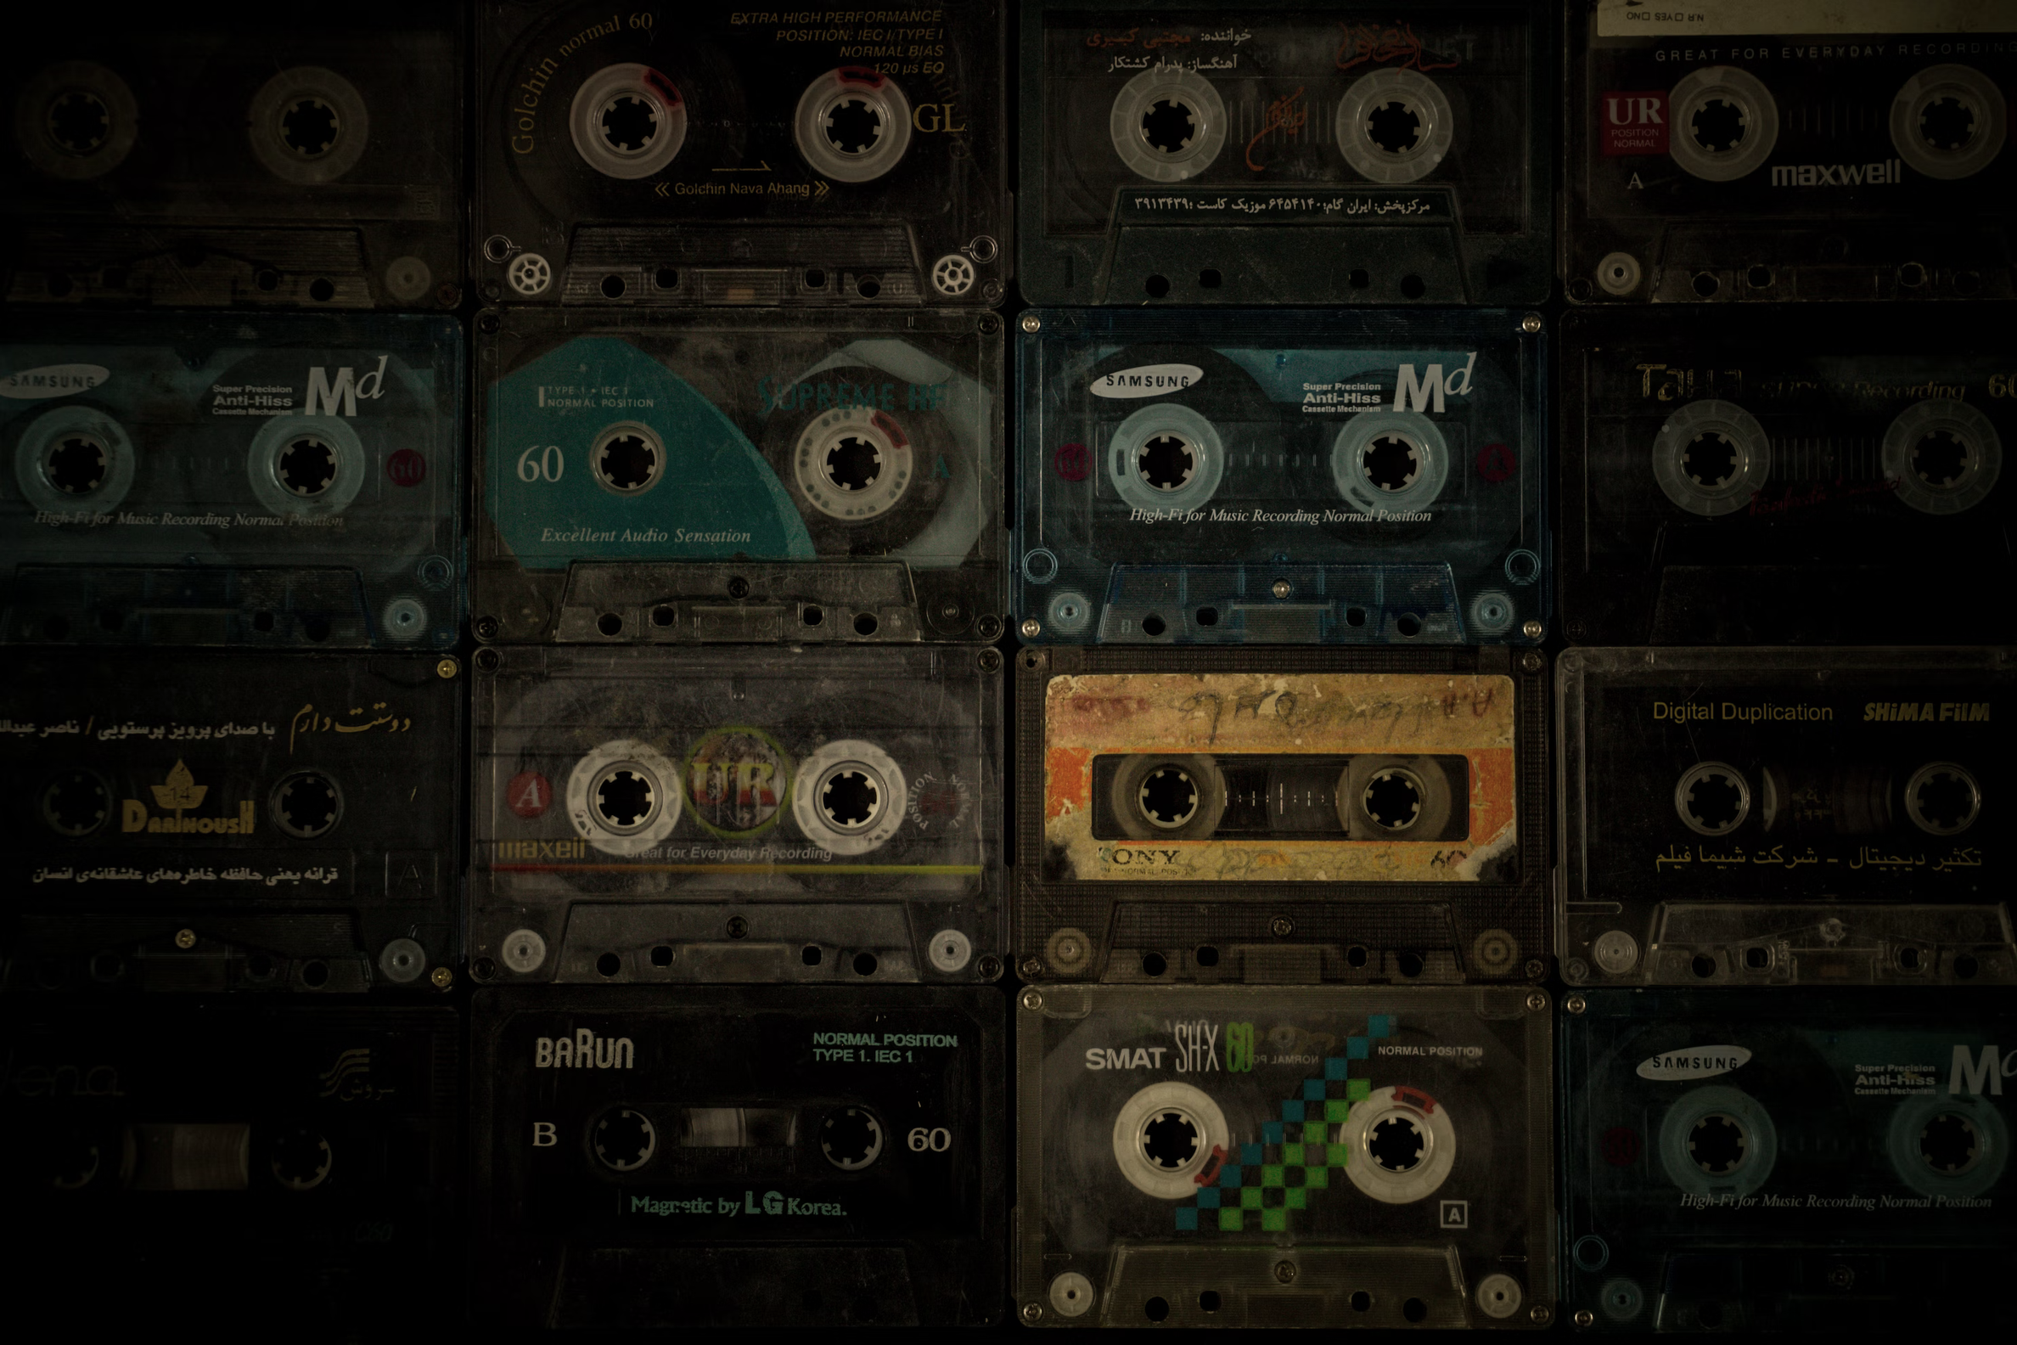


CSE 583 Project
THANK YOU!
https://github.com/CSE583-Fall2023-Project/Spotify-Music-Recommendation-System
Juntong Wu: juntongw@uw.edu
Denkie Yan: denkie@uw.edu
Chesie Yu: cyu909@uw.edu
PAUSE

